Slide 1
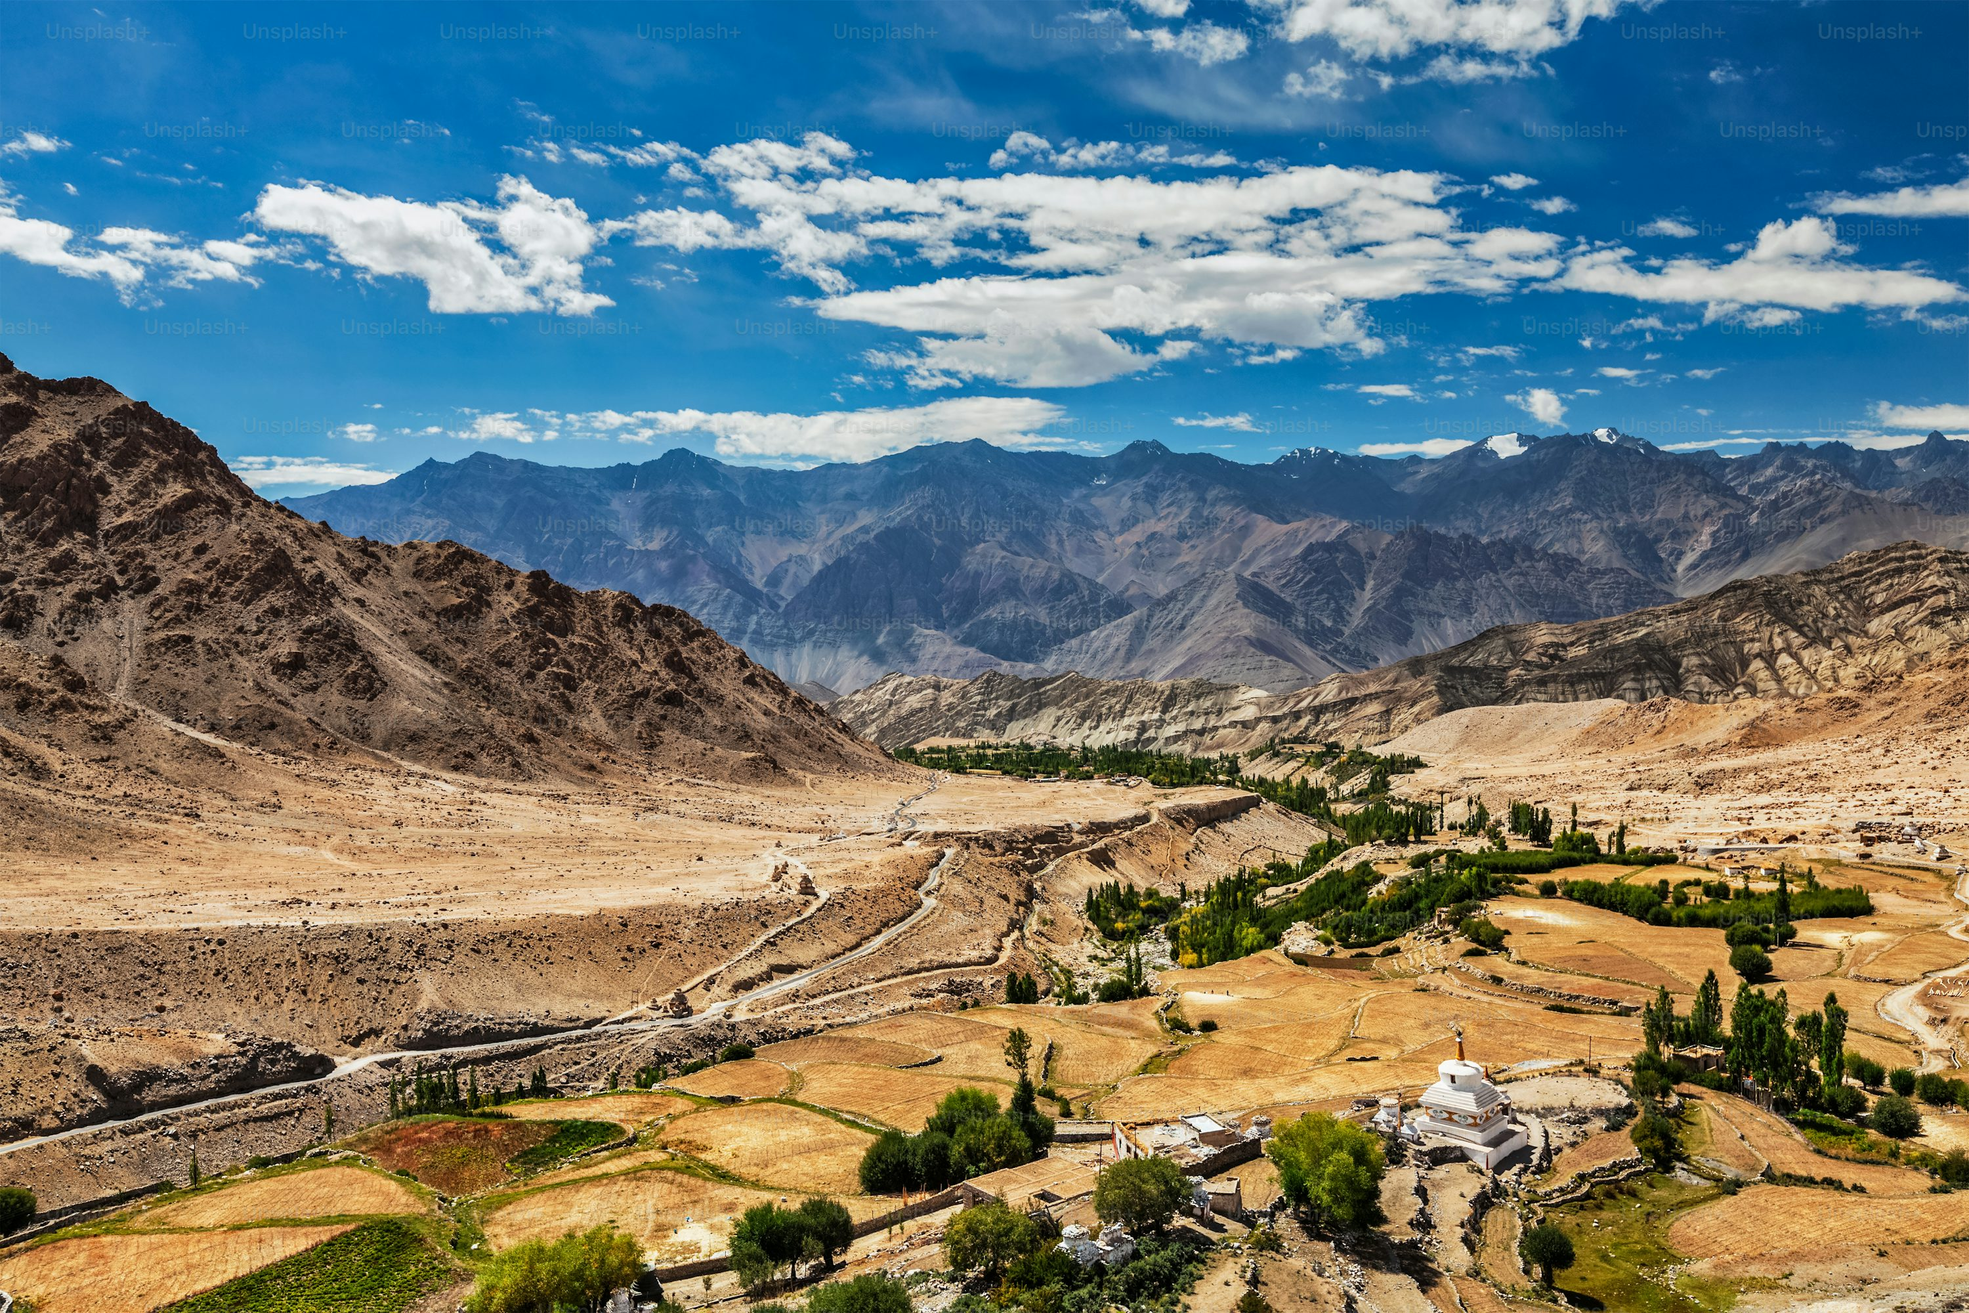
Balochistan: Land of Culture, Nature, and Tradition

Slide 2
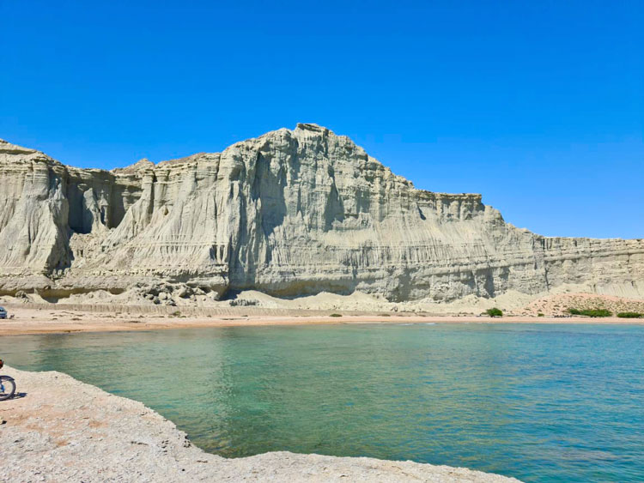
introduction
Every country has its own unique culture, religion, and lifestyle.
These elements shape how people think, live, and interact with one another.
They also reflect the nation’s values, traditions, and way of progress.
This presentation highlights important aspects such as nature, food, equality, and national resources.

Slide 3
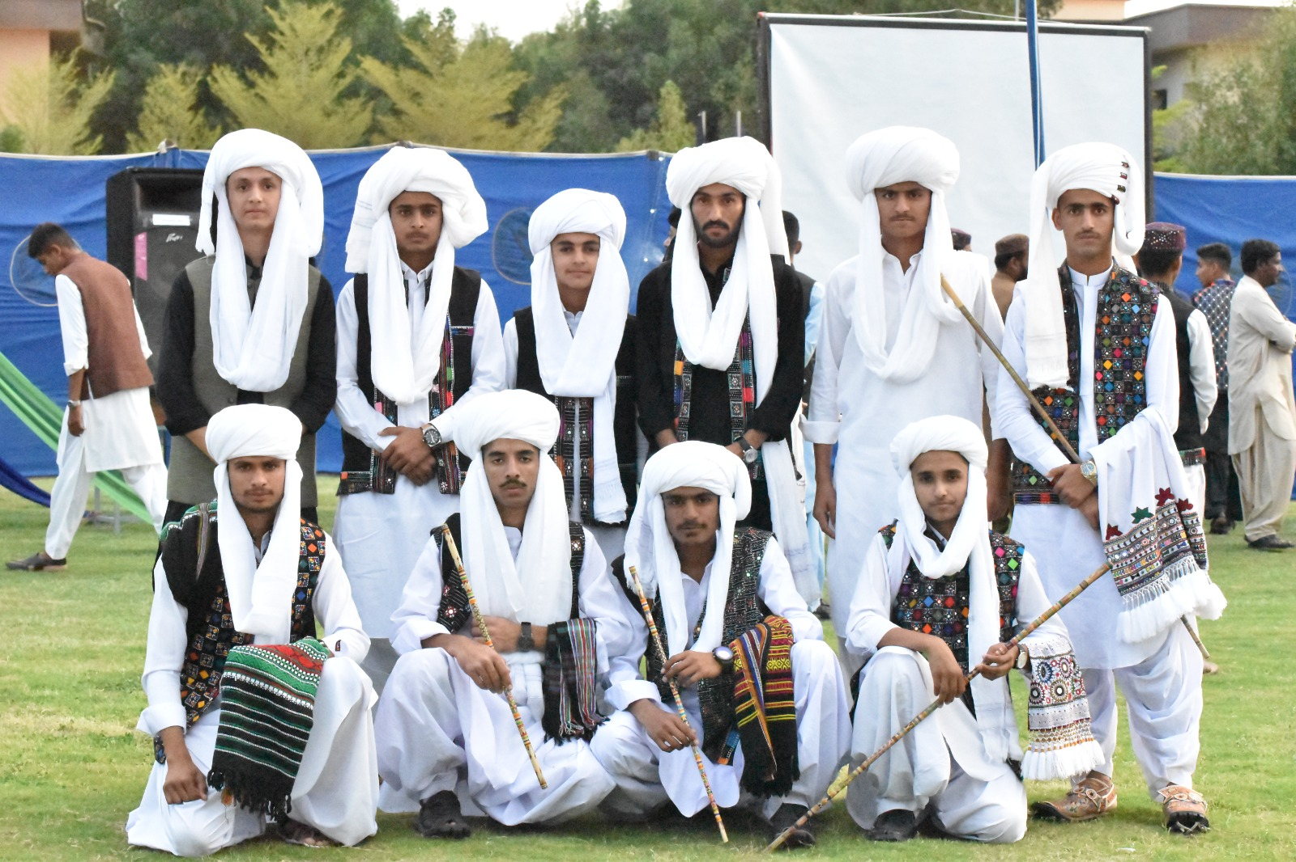
Culture
Culture
Represents the way people live, think, dress, and celebrate.
Includes traditions, festivals, art, music, and language.
Builds unity, identity, and pride among people.
Example: Pakistani culture values family, hospitality, and colorful traditions.
Represents the way people live, think, dress, and celebrate.
Includes traditions, festivals, art, music, and language.
Builds unity, identity, and pride among people.
Example: Pakistani culture values family, hospitality, and colorful traditions.

Slide 4
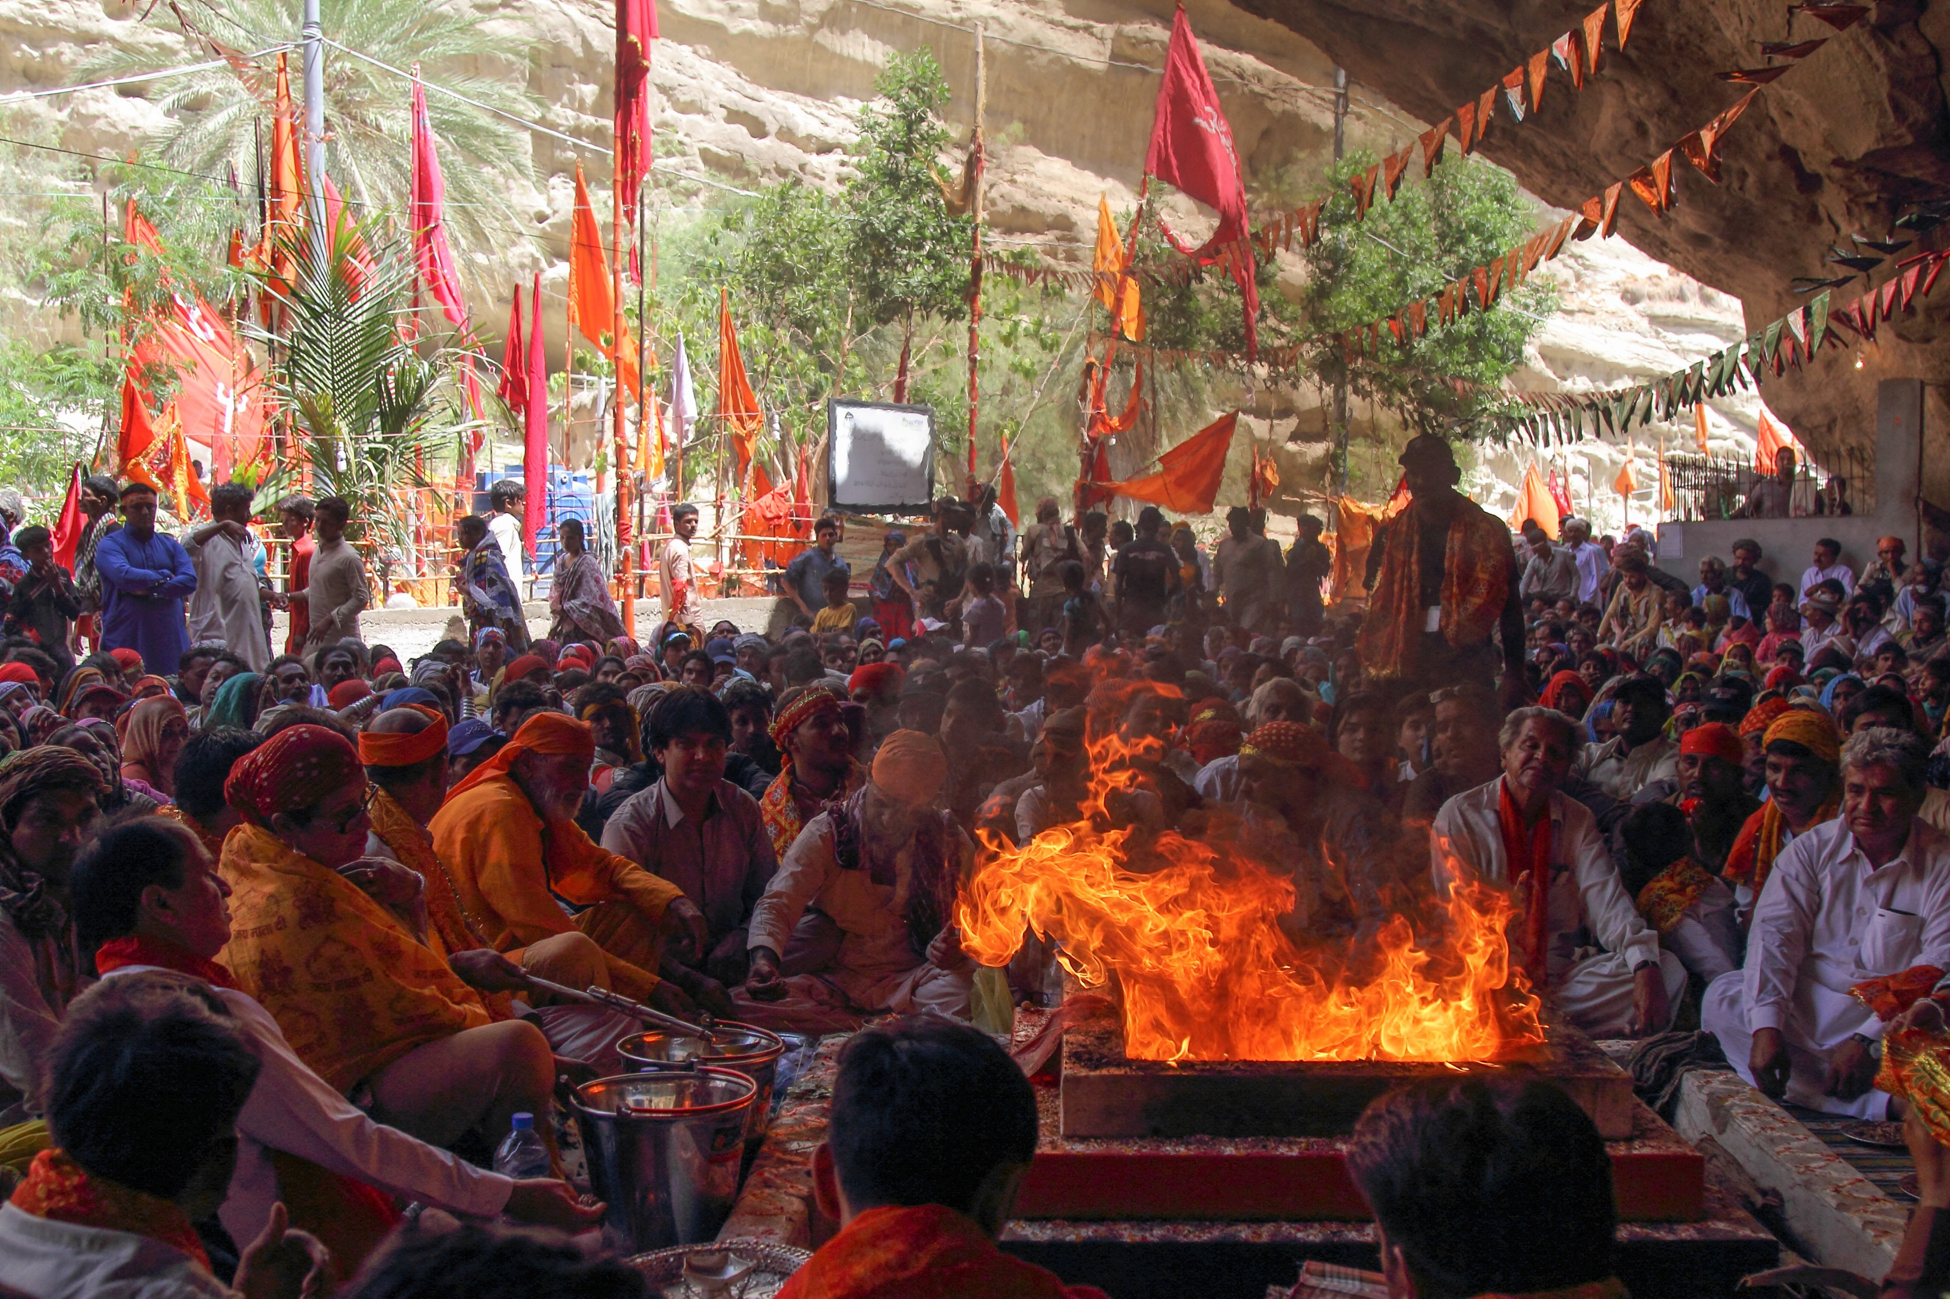
Religion
Guides people on how to live a moral and peaceful life.
Teaches values like kindness, respect, and honesty.
People follow different religions such as Islam, Christianity, and Hinduism.
Promotes unity, hope, and compassion among all people.
Guides people on how to live a moral and peaceful life.
Teaches values like kindness, respect, and honesty.
People follow different religions such as Islam, Christianity, and Hinduism.
Promotes unity, hope, and compassion among all people.

Slide 5
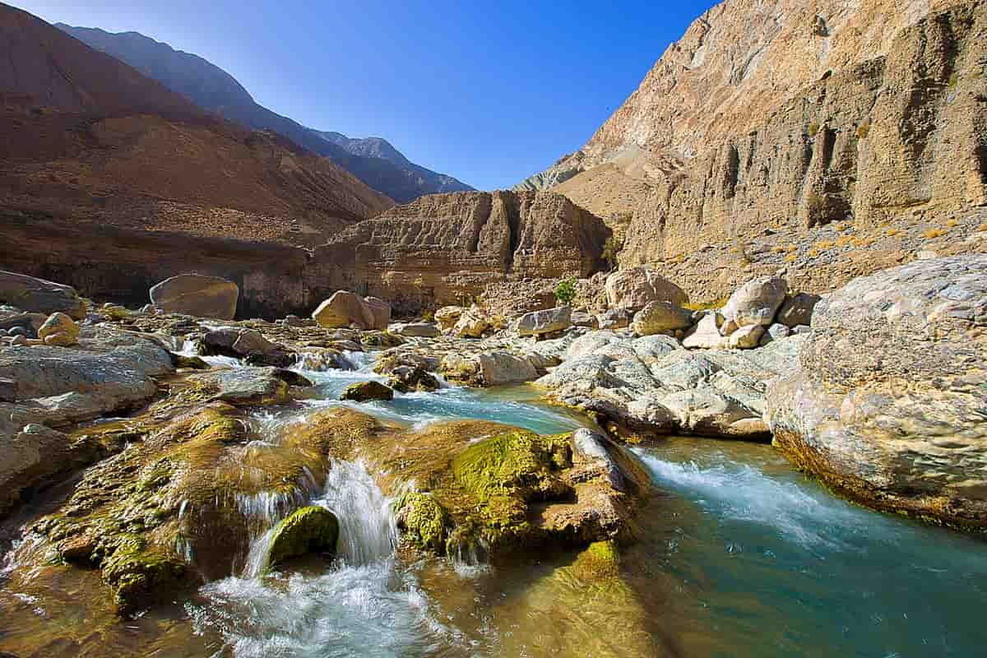
NATURE
.
Includes all living and non-living things like trees, rivers, and animals.
Provides food, water, air, and shelter for survival.
Keeps the Earth balanced and healthy.
Needs protection from pollution and deforestation.

Slide 6
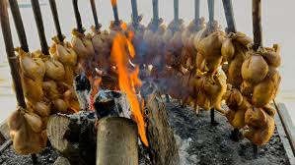
FOODS
Reflects the culture and lifestyle of a nation.
Made from local crops, spices, and traditions.
Brings families and communities together.
Example: Pakistani dishes like biryani and kebabs show cultural richness.

Slide 7
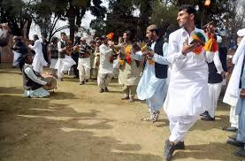
How people live
People live in cities, towns, and villages with different lifestyles.
City life is fast, modern, and technology-based.
Village life is peaceful, natural, and community-oriented.
Family and social bonds are important in all lifestyles.

Slide 8
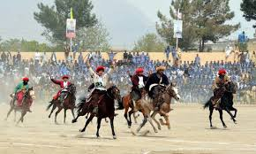
National games
Symbolizes a country’s pride and unity.
Encourages teamwork, sportsmanship, and discipline.
Example: Field Hockey is the national game of Pakistan.
Brings international recognition and national honor.

Slide 9
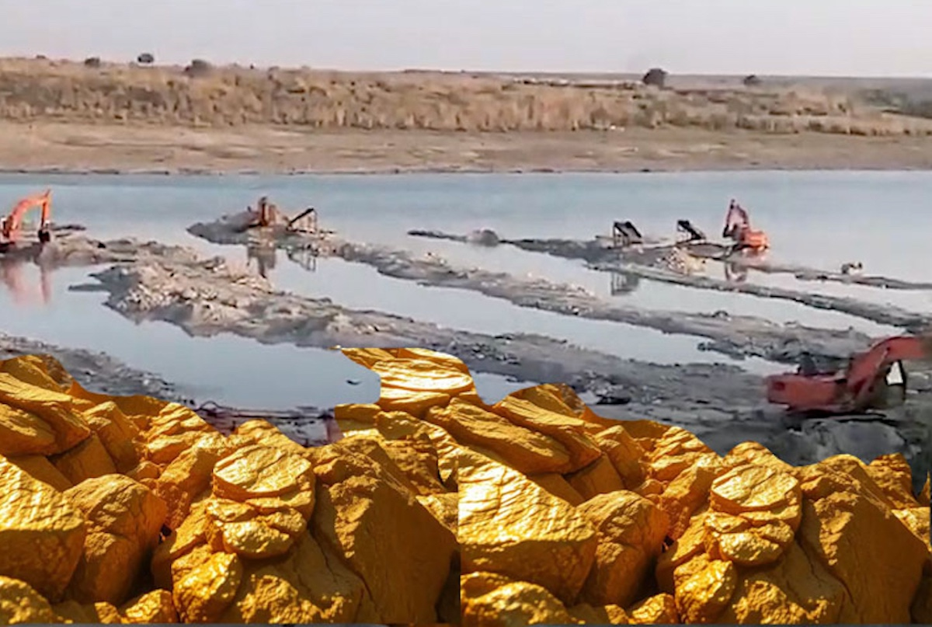
Mineral And Resources
Include coal, gas, oil, salt, gold, and copper.
Support industries, economy, and daily life.
Natural resources must be used wisely and conserved.
Pakistan is rich in minerals that help in national development.

Slide 10
Conclusion
Culture, religion, and nature shape a nation’s identity.
Equal rights and unity make a society strong.
Respecting nature and using resources wisely ensures a bright future.
Together, these elements create peace, progress, and national pride.

Slide 11
Thank you

